Slide 1
Q1 2013 CAR Analysis
Team:
Bill Konigsfeld
Alan Purvey
Jenni Murrill

Slide 2
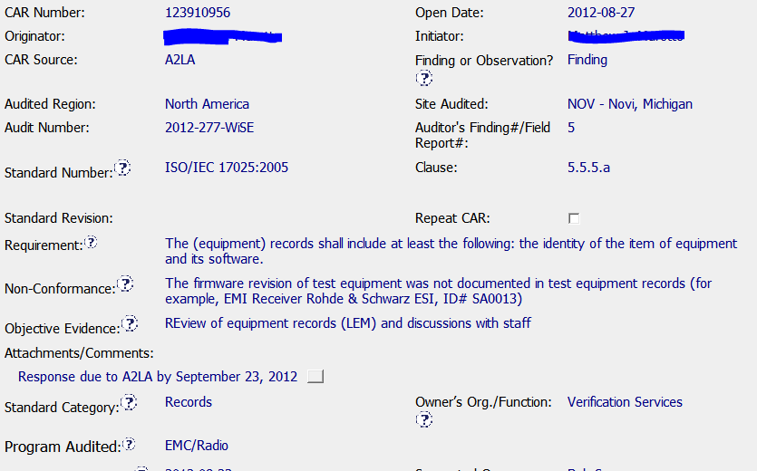
Exemplary Finding - 123910956
Background
Equipment description and ID included
Accreditor Due Date

Slide 3
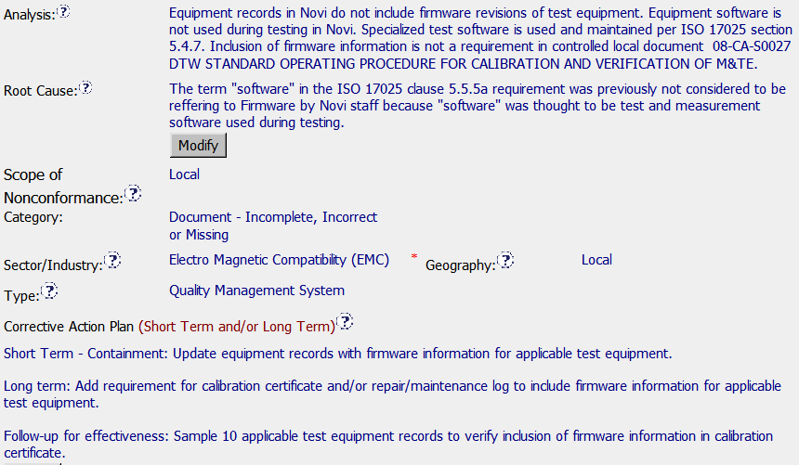
Exemplary Finding - 123910956
Clear explanation of how this was overlooked and support of root cause.
Response
Clear, concise Root Cause
Suggested Scope: Novi test equipment with firmware.
Could have included stakeholders
Containment & Verification

Slide 4

Exemplary Finding - 123910956
Milestones
Containment, Long Term and Verification Included.
Implemented with equipment staff through exercise
of updating equipment in LEM.

